Slide 1
DATA ON RI POPULATION AGES 65+ and 85+ Nursing Home – Assisted Living Locations Presented to Carson Commission To Study and Provide Recommendations Pertaining to Services and Coordination of State Programs Relating to Older Adult Rhode Islanders January 26, 2024
Presented by: Maureen Maigret, RN BS MPA

Slide 2
RI CITY & TOWN POPULATION BY AGES 65+ and 85+ - # of NURSING HOMES AND ASSISTED LIVING

Slide 3
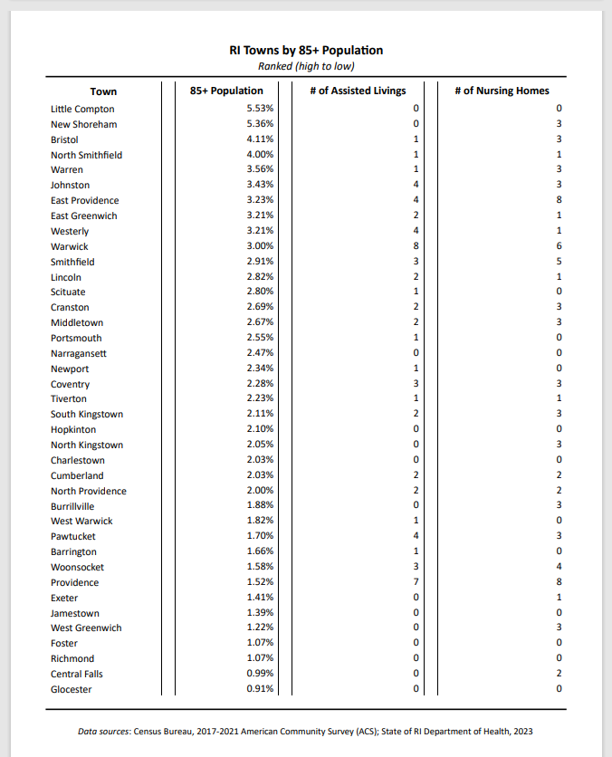

Slide 4
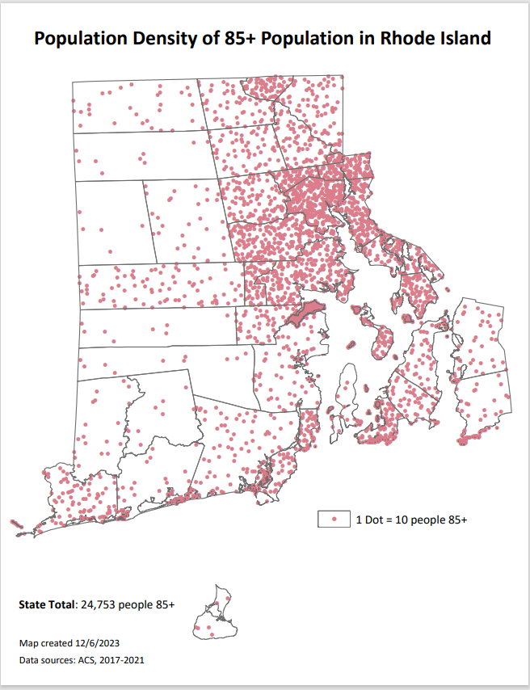

Slide 5
